Slide 1
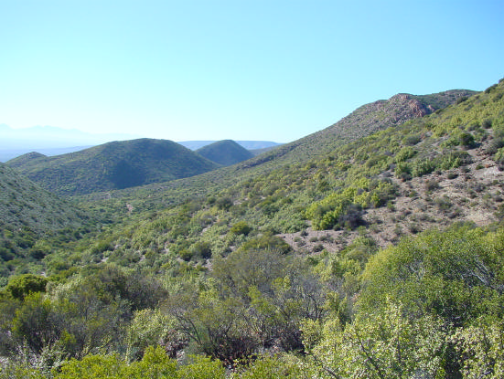
Very High Resolution Remote Sensing of Portulacaria afra Canopy Cover
Dugal Harris (MSc Elec Eng)
Supervisor: Dr A Van Niekerk
Department of Geography & Environmental Studies
Stellenbosch University

Slide 2
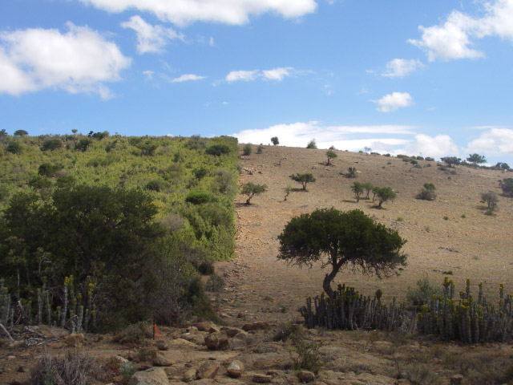
Background
Portulacaria afra (Spekboom) is an evergreen succulent tree that occurs in the subtropical thicket biome throughout much of the E. Cape and Little Karoo.
It is sensitive to over-grazing by goats and has been degraded over much of its range (Mills et al. 2005).

Slide 3
Background
Spekboom is very effective at storing carbon compared to other arid region vegetation (Mills et al. 2005).
Spekboom restoration can be funded by trading carbon credits on the international carbon market (Marais, Cowling & Powell 2009).
Restoration helps provide ecosystem services and employment in impoverished areas (Mills & Cowling 2006).
Restoration research and pilot studies are underway.
Spekboom canopy cover maps are needed to help select and monitor restoration sites.
Canopy cover provides information on the level of degradation, economic feasibility and progress of restoration.
There is an initiative to involve private land owners in restoration. Canopy cover maps at 1:10000 scale are required to work at a farm level.

Slide 4
Aims and Objectives
Aim
  The research aim is to develop an automated or semi-automated image analysis technique to accurately estimate P. afra canopy cover from very high resolution (VHR) remotely sensed imagery, covering large areas.
Objectives
Conduct a literature survey.
Perform a field study to establish reference sites with ground truth.
Source and calibrate imagery from National Geo-spatial Information (NGI).
Develop a classifier that distinguishes Spekboom from surrounding vegetation & determine Spekboom canopy cover from the classification results.
Apply the canopy cover estimation to the Little Karoo and interpret results. Conduct a second field study to validate the results.

Slide 5
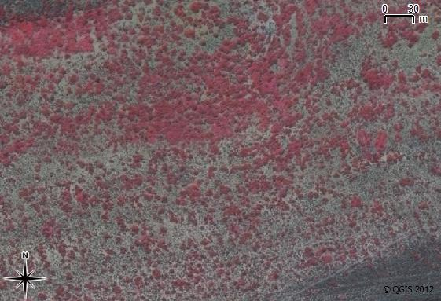
Significance and Rationale
Measures of canopy cover can be used to infer biomass for individual species.
VHR (0.5m) NGI imagery has not been used for automated vegetation monitoring.
Use of VHR imagery for environmental monitoring of large areas is uncommon.
Arid regions present some remote sensing challenges not typically encountered in forests.
Dealing with sources of unwanted variation.

Slide 6
Research Methodology
A quantitative remote sensing approach will be followed to facilitate accurate canopy cover estimation of large areas and at repeated intervals.
Empirical methods will be used for developing and validating the canopy cover estimation.
This study is intended to be applied research.
Collaboration with Jan Vlok (a botanist with significant experience in the Little Karoo).

Slide 7
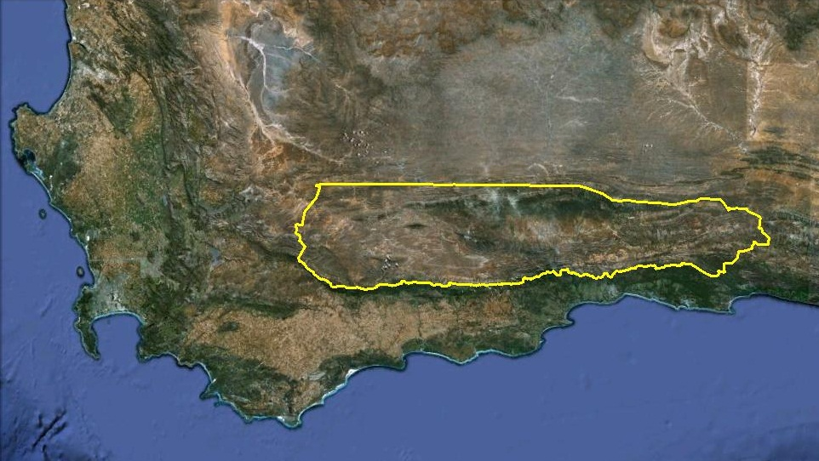
Research Methods: Study Area
Subtropical thicket makes up 35% of the Little Karoo of which roughly 90% is degraded to some extent (Vlok, Cowling & Wolf 2005; Thompson et al. 2009).
A number of relevant studies have been performed in the area which will provide useful ancillary and validation data (Forsyth, Vlok & Reyers 2008).

Slide 8
Research Methods: Field Study and Ground Truthing
In collaboration with Jan Vlok, a number of field sites will be identified that encompass the various thicket habitat types and levels of degradation.
Canopy cover ground truth will be established for each site using visual inspection and manual delineation of Spekboom canopy in aerial images.

Slide 9
Research Methods: Image Calibration
NGI imagery will be orthorectified using the existing aero-triangulation information.
A digital surface model (DSM) will be constructed as an output of the rectification.
Radiometric consistency will be visually and quantitatively evaluated.
Correction for viewing geometry will likely be required. Existing methods will be researched and evaluated.

Slide 10
Research Methods: Canopy Cover Mapping Algorithm
The canopy cover mapping algorithm will be a two stage process:
  Spekboom trees and tree clumps will be distinguished from the surrounding vegetation. A one-class classification approach will be adopted. Texture features, vegetation indices and ancillary data (such as slope orientation and plant height) will be evaluated for their discriminative ability.
  Topographical effects will be corrected with a flattening transform and canopy cover evaluated.

Slide 11
Research Methods: Application
A canopy cover map will be produced for the Little Karoo and interpreted in collaboration with Jan Vlok.
Intact Spekboom canopy covers for various regions and habitat types will be extracted and used to create a degradation index for transformed areas.
Results will be validated through visual photo-interpretation and inspections of randomly selected sites.

Slide 12
Timelines and Deliverables
No. | Task Description | Deliverable | Jun-12 | Aug-12 | Oct-12 | Dec-12 | Feb-13 | Apr-13 | Jun-13 | Aug-13 | Oct-13
1 | Literature survey
2 | Field study & ground truthing
3 | Image calibration
4 | Canopy cover mapping | Paper
5 | Application | Map & paper
 | Thesis | Thesis

Slide 13
References
Eisfelder C, Kuenzer C & Dech S 2012. Derivation of biomass information for semi-arid areas using remote-sensing data. International Journal of Remote Sensing 33 (9): 2937–2984.
Forsyth G, Vlok J & Reyers B 2008. Retention and restoration of the biodiversity of the Little Karoo. CSIR Report No CSIR/NRE/ECO/ER/2008/0118/C. Critical Ecosystem Partnership Fund, CSIR.
Lu D 2006. The potential and challenge of remote sensing based biomass estimation. International Journal of Remote Sensing 27 (7): 1297-1328.
Marais C, Cowling RM & Powell M 2009. Establishing the platform for a carbon sequestration market in South Africa: The Working for Woodlands Subtropical Thicket Restoration Programme. In XIII World Forestry Congress, 1-13. Buenos Aires, Argentina.
Mills AJ, Cowling RM, Fey M, Kerley G, Donaldson J, Sigwela A, Skowno A & Rundel P 2005. Effects of goat pastoralism on ecosystem carbon storage in semiarid thicket , Eastern Cape , South Africa. Austral Ecology 30: 797-804.
Mills AJ & Cowling RM 2006. Rate of carbon sequestration at two thicket restoration sites in the Eastern Cape, South Africa. Restoration Ecology 14 (1): 38-49.
Thompson M, Vlok J, Rouget M, Hoffman MT & Cowling RM 2009. Mapping grazing-induced degradation in a semi-arid environment: A rapid and cost effective approach for assessment and monitoring. Environmental Management 43: 585-596.
Vlok J, Cowling RM & Wolf T 2005. A vegetation map for the Little Karoo. Unpublished maps and report for a SKEP project supported by CEPF grant no 1064410304.

Slide 14
Questions?

